Slide 1
A
REPORT
ON
SECOND MINOR PROJECT
UNDER
SUMMER INTERNSHIP
ON
DATA SCIENCE AND MACHINE LEARNING
Project for Sports Team Management
Submitted To: Submitted By:
Mr. Rishu Dwivedi Shivam Purohit
Trainer (Learn & Build) (21EGJCS138)
DEPARTMENT OF COMPUTER ENGINEERING
POORNIMA INSTITUTE OF ENGINEERING &amp; TECHNOLOGY, JAIPUR
(Academic Year 2023-24) (ODD)

Slide 2
Section 1: Introduction
Introduction:
With the intense competition and evolving dynamics of T20 cricket, it's essential to make strategic decisions that give us a competitive edge As cricket enthusiasts and data analysts, we understand that assembling the right team can make all the difference in a high-stakes tournament like the IPL
Motivation:
“Our aim is to leverage the power of data analytics to recommend top-performing players who can significantly enhance the new team's chances of triumph"
Problem Statement:
A sports management company is interested in forming a new team for the upcoming IPL Season 2024 and want a model to suggest players that will maximize their chances of winning matches. Analyze the IPL dataset and recommend the top-performing players in various positions to include in the new team

Slide 3
Section : Data Introduction
Batting Dataset:
IPL Dataset:
POS: Batting position
Player: Name of the cricket player
Mat: Total matches played
Inns: No of times the player went in to bat
NO: No of times the player was not out
Runs: Total runs scored
HS: Highest score achieved
Avg: Batting average
BF: Total balls faced
SR: Batting strike rate
100: No of centuries scored
50: No of half-centuries scored
4s: No of fours hit
6s: No of sixes hit
Ball_key: Unique ball identifier.
MatcH_id: Match identifier.
Over_id: Over identifier within a match.
Ball_id: Ball identifier within an over.
Innings_No: Inning number (1 or 2).
Team_Batting: Batting team's name.
Team_Bowling: Bowling team's name.
Striker_Batting_Position: Striker's batting position.
StrikerKey: Striker's identifier.
NonStrikerKey: Non-striker's identifier.
BowlerKey: Bowler's identifier.
Extra_Type: Type of extra (wide, no ball, etc.).
Runs_Scored: Runs scored.
Extra_runs: Extra runs conceded.
Legbyes: Number of leg bye runs.
Byes: Number of bye runs.
Noballs: Number of no-ball deliveries.
Penalty: Number of penalty runs.
Bowler_Extras: Bowler's extra runs.
Out_type: Type of dismissal (caught, bowled, etc.).
Caught: Batsman caught out.
Bowled: Batsman bowled out.
Run_out: Batsman run out.
LBW: Leg before wicket dismissal.
Retired_hurt: Batsman retired hurt.
Stumped: Batsman stumped out.
Bowling Dataset:
Wides: Number of wide deliveries.
caught_and_bowled: Caught and bowled dismissal.
hit_wicket: Batsman dismissed hit wicket.
ObstructingFeild: Obstructing the field dismissal.
Bowler_Wicket: Bowler's wickets taken.
Match_Date: Match date.
Season: IPL season.
Striker: Striker's name.
Non_Striker: Non-striker's name.
Bowler: Bowler's name.
Player_Out: Dismissed player's name.
Fielders: Fielders involved in dismissal.
POS: Position in the team's bowling order
Player: Name of the cricket player
Mat: Total matches played
Inns: No of times the player bowled
Ov: Total overs bowled
Runs: Total runs conceded
Wkts: Total wickets taken
BBI: Best bowling figure achieved
Avg: Bowling average
Econ: Bowling economy rate
SR: Bowling strike rate
4w: No of times 4 wickets in an inning
5w: No of times 5 wickets or more in an
inning

Slide 4
Section : Exploratory Data Analysis (EDA)
Identify Key Performance Batting Metrics:
(a) Batting Average
(b)Strike Rate
(c) Centuries (100s) and Half-Centuries (50s)
(d)Boundary Percentage
Bowling Metrics:
(a). Economy Rate
(b). Bowling Strike Rate
(c). Wickets
(d). Dot Ball Percentage
POS | Player | Mat | Inns | NO | Runs | HS | Avg | BF | SR
1 | Jos Buttler | 17 | 17 | 2 | 863 | 116 | 57.53 | 579 | 149.05
2 | KL Rahul | 15 | 15 | 3 | 616 | 103* | 51.33 | 455 | 135.38
3 | Quinton Kock | 15 | 15 | 1 | 508 | 140* | 36.29 | 341 | 148.97
4 | Hardik Pandya | 15 | 15 | 4 | 487 | 87* | 44.27 | 371 | 131.26
5 | Shubman Gill | 16 | 16 | 2 | 483 | 96 | 34.5 | 365 | 132.32
POS | PLAYER | Player | Mat | Inns | Ov | Runs | Wkts | BBI | Avg | Econ
1 | Yuzvendra | Chahal | 17 | 17 | 68 | 527 | 27 | 40/5 | 19.51 | 7.75
2 | Wanindu | Hasaranga | 16 | 16 | 57 | 430 | 26 | 18-May | 16.53 | 7.54
3 | Kagiso | Rabada | 13 | 13 | 48 | 406 | 23 | 33/4 | 17.65 | 8.45
4 | Umran | Malik | 14 | 14 | 49.1 | 444 | 22 | 25-May | 20.18 | 9.03
5 | Kuldeep | Yadav | 14 | 14 | 49.4 | 419 | 21 | 14-Apr | 19.95 | 8.43
Pos | 100s | 50s | 4s | 6s | Batting Avg. | Strike Rate | Boundary Per.
1 | 4 | 4 | 83 | 45 | 57.533333 | 149.050086 | 14.831981
2 | 2 | 4 | 45 | 30 | 51.333333 | 135.384615 | 12.175325
3 | 1 | 3 | 47 | 23 | 36.285714 | 148.973607 | 13.779528
4 | 0 | 4 | 49 | 12 | 44.272727 | 131.266846 | 12.525667
5 | 0 | 4 | 51 | 11 | 34.5 | 132.328767 | 12.836439
POS | SR | 4W | 5W | Economy Rate | Bowling Strike Rate | Dot Ball Per.
0 | 15.11 | 1 | 1 | 7.75 | 2.518519 | 7.617647
1 | 13.15 | 1 | 1 | 7.54386 | 2.192308 | 7.385965
2 | 12.52 | 2 | 0 | 8.458333 | 2.086957 | 8.291667
3 | 13.4 | 1 | 1 | 9.04277 | 2.231818 | 8.85947
4 | 14.19 | 2 | 0 | 8.481781 | 2.352381 | 8.319838

Slide 5
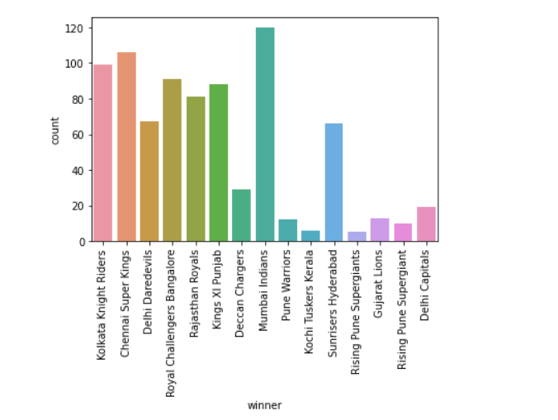
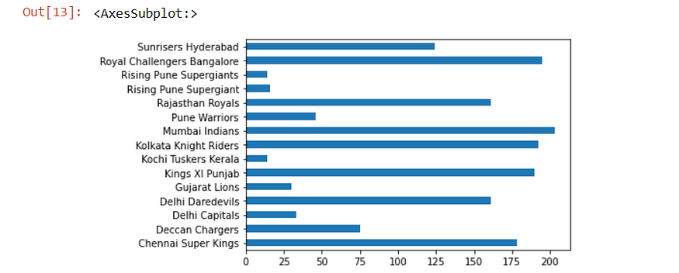
Section : Exploratory Data Analysis (EDA)
Based on runs, Top 6 batsmen are:
Based on overs, Top 6 bowlers are:
POS | Player | Player | Runs
0 | Jos | Buttler | 863
1 | KL | Rahul | 616
2 | Quinton | Kock | 508
3 | Hardik | Pandya | 487
4 | Shubman | Gill | 483
5 | David | Miller | 481
Pos | Player | Player | Ov
0 | Yuzvendra | Chahal | 68
28 | Ravichandran | Ashwin | 67
9 | Prasidh | Krishna | 66.3
7 | Rashid | Khan | 63.5
14 | Trent | Boult | 62
Matches Played by Each Team
Matches Won by Each Team

Slide 6
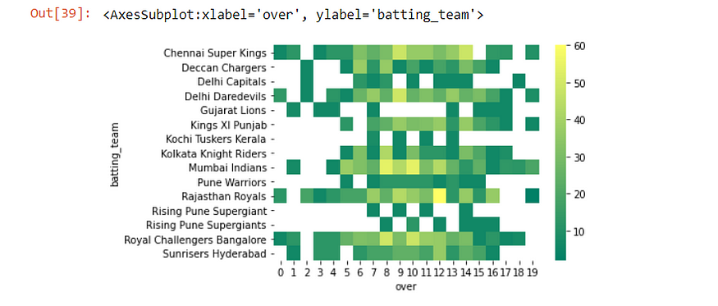
Section : Model Predictions
Over-wise Batting Performance of Each Team in the IPL (2008–2020)

Slide 7
Section : Limitations
Contextual Dynamics:
Next Steps:
Data Completeness and Quality:
Our analysis relies on historical data, subject to data quality issues, missing values, and potential inaccuracies. This may affect the accuracy of our recommendations.
Player form and fitness can evolve rapidly, and recent performance data might be more relevant. Our reliance on historical data might not fully capture current player capabilities.
Cricket, especially in T20 format, is influenced by numerous dynamic factors: pitch conditions, match situations, opposition strengths, and more. Our model doesn't account for these dynamic contextual aspects.
The dataset's focus on individual player performance might overlook the intricate team strategies that underpin successful IPL campaigns.
If we were to redo the project, integrating real-time data would be invaluable, enabling us to capture the latest player form and contextual dynamics.
A more comprehensive model could incorporate machine learning techniques, leveraging ensemble methods or neural networks to better capture the nonlinear relationships inherent in cricket.
Furthermore, partnering with cricket experts to guide variable selection and model interpretation would provide a holistic perspective.

Slide 8
Section 5: Conclusion
Key Results:
Final Takeaways:
Future Endeavors:
Our comprehensive analysis identified top-performing players across batting and bowling, contributing to the formation of a formidable IPL team.
The regression analysis underscored the significance of key performance metrics such as batting average, strike rate, and bowling economy in shaping player contributions.
Our recommendations offer a foundation for informed player selection, laying the groundwork for a competitive team.
Data analytics is a powerful tool in optimizing player selection and team composition, contributing to a more strategic and competitive approach in IPL.
While our analysis provides actionable insights, cricket's nuanced and evolving nature mandates continuous assessment and adaptation.
Exploring advanced modeling techniques and machine learning algorithms would provide richer insights, capturing the complex relationships inherent in cricket dynamics.
Integrating real-time and contextual data would enhance the timeliness and relevance of our recommendations.
Collaborating with cricket experts would bridge the gap between data insights and on-field strategy.

